Slide 1
Day 2 4 June, 2024

Slide 2
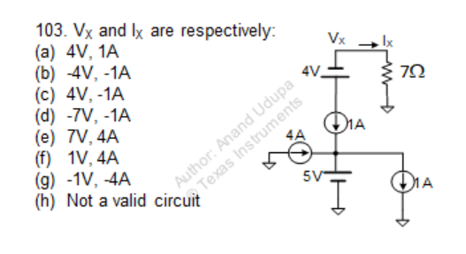
Question 1

Slide 3
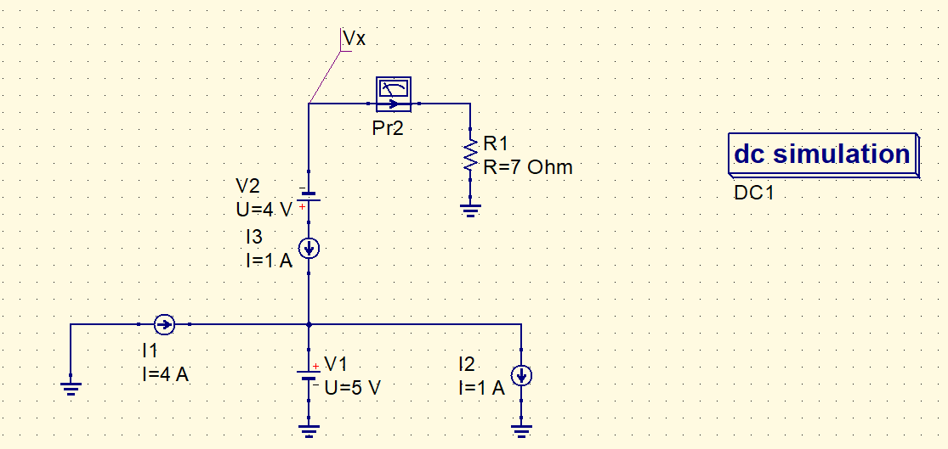
QUCS circuit
- Vx used to label the node,
- Current probe (Pr2) to check current in that branch.

Slide 4
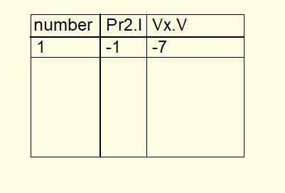
QUCS result
Conclusion:
In a series circuit, the current that flows through each of the components is the same.
A voltage source and current source in series is equivalent to a current source in series.

Slide 5
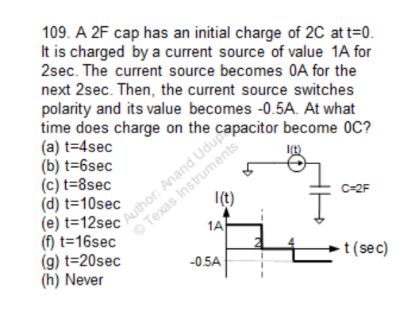
Question 2
Hint:
Use pulse current to generate the current waveform.
You can set initial voltage on cap by double clicking it.
Use cartesian plot in the diagrams section.

Slide 6
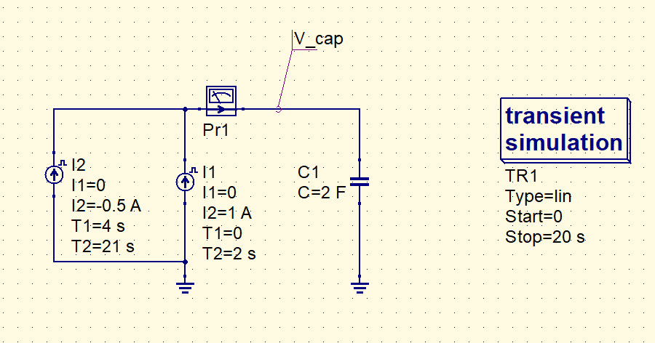
QUCS circuit
Combination of two pulse currents is used to generate the required current waveform.
Initial voltage of 1 V is set for the capacitor.

Slide 7
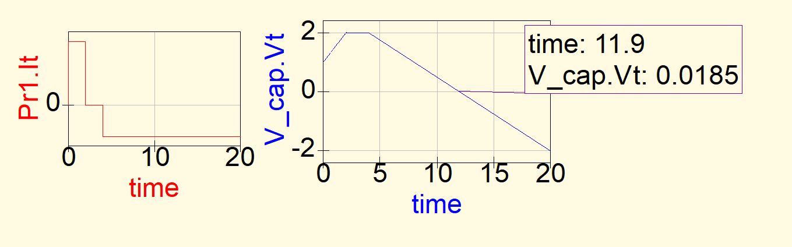
QUCS Result
- At time , t = 12 s roughly we get 0V across the cap (as per simulation)

Slide 8
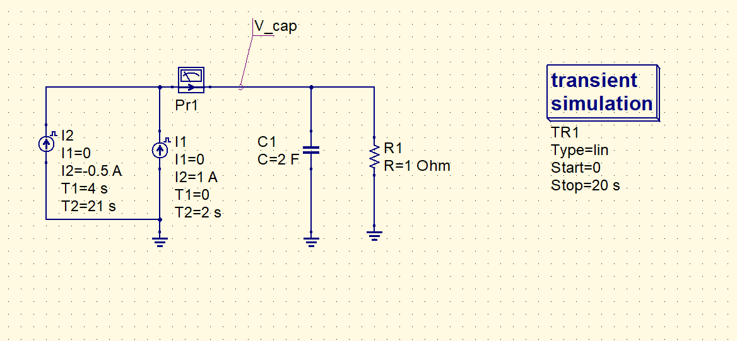
Conclusion
Given that the capacitor has 2 C of charge stored in it, it has an initial voltage of V = Q/C = 1V.
The first 2 seconds, the capacitor gets charged to 2 V . [ V(t) = V(0) + I0/C * t ]
The next 2 seconds, the 2 V is maintained across the capacitor.
Then , current source of value – 0.5 A starts to discharge the capacitor. At t = 12 s, the cap voltage becomes 0V as per calculations.
Let’s try simulating for the case if the cap was non-ideal:
Note: Assume initial condition in cap to be 0

Slide 9
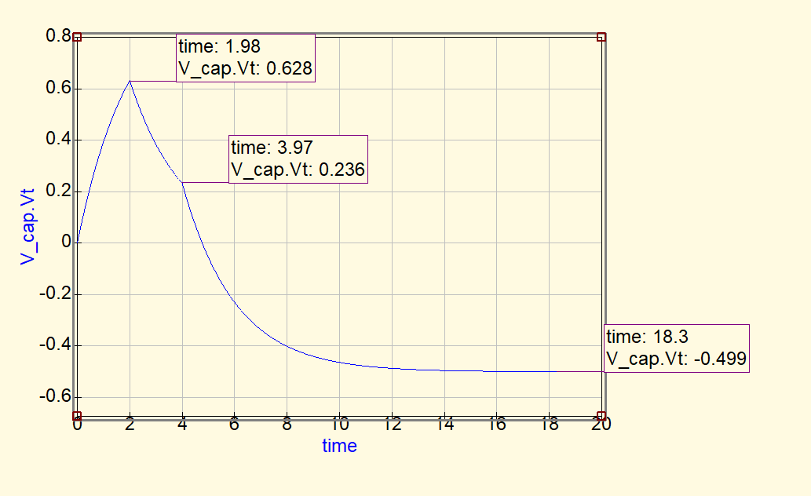
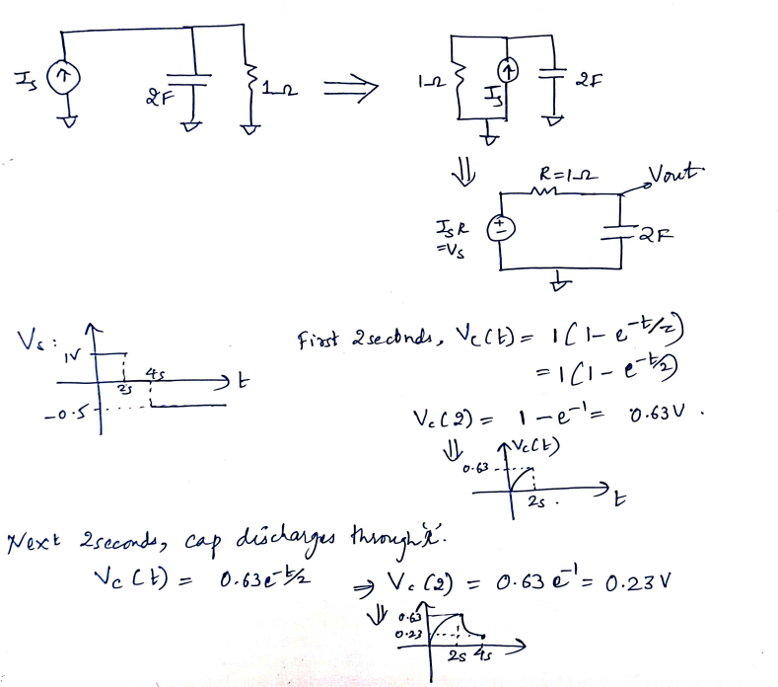
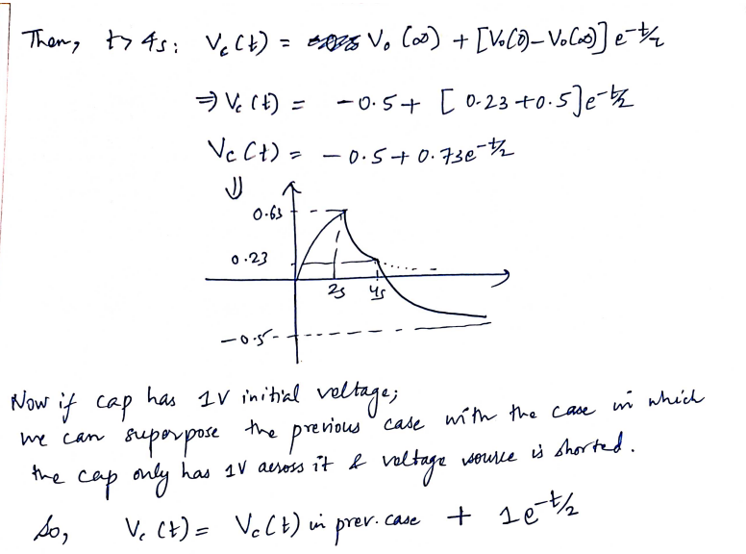
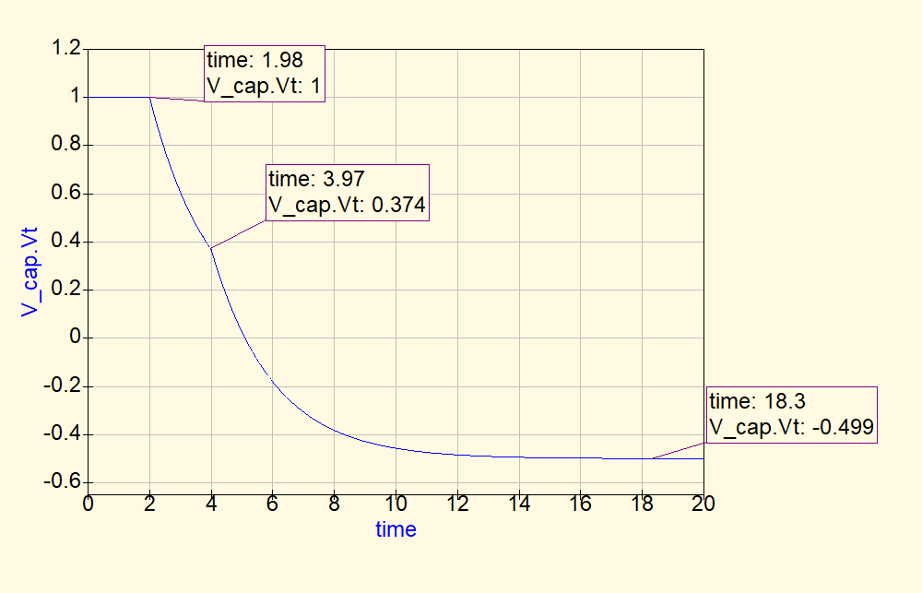
QUCS Result for the case with non-ideal capacitor
So, how do you explain this waveform?
Use the Thevenin equivalent model of the circuit.
Then, its RC circuit charging and discharging.
No initial voltage on cap
1V initial voltage on cap

